Slide 1
UNDERSTAND & TROUBLESHOOT
Understand Office Network, Equipment and There Troubleshoot
By Naveen Mittal
9837232876

Slide 2
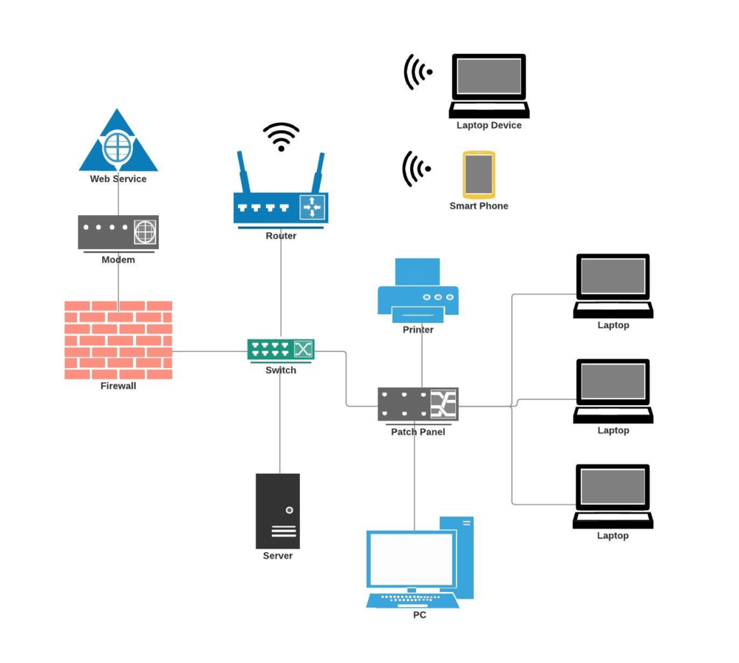
LAYOUT OF OFFICE NETWORK

Slide 3
NETWORKING – LAN
WHAT IS A LOCAL AREA NETWORK (LAN)?
A local area network (LAN) is a group of computers and peripheral devices that are connected together within a distinct geographic area, such as an office building or campus. The devices are connected via a common communications line or wireless connection to a server.

Slide 4
HOW DOES A LAN WORK ?
LAN networking typically requires Ethernet cables and Layer 2 (L2) switches along with devices that can connect and communicate using Ethernet. Larger LANs often include L3 switches or routers to streamline traffic flows. Each device connected to a LAN is assigned a unique IP address that maps to its physical address, also known as the media access control (MAC) address. Ethernet switches use the device's MAC address to transport data across the network. A LAN enables users to connect to internal servers, websites and other LANs that belong to the same wide area network (WAN). Ethernet and Wi-Fi are the two primary ways to enable LAN connections. Ethernet is an IEEE specification for physical network connections that enables computers to communicate with each other. Wi-Fi uses radio waves in the 2.4 gigahertz and 5 GHz spectrum to connect computers to the LAN. Legacy LAN technologies, including token ring, Fiber Distributed Data Interface and Attached Resource Computer Network, have lost favor as Ethernet and Wi-Fi speeds increased and connectivity costs decreased

Slide 5
WIRED | WIRELESS | VIRTUAL LAN
WIRED LAN
A wired LAN uses switches and Ethernet cabling to connect endpoints, servers and IoT devices to the corporate network. For small businesses with only a handful of devices, a wired LAN can consist of a single unmanaged LAN switch with enough Ethernet ports to interconnect all devices.

Slide 6
WIRED | WIRELESS | VIRTUAL LAN
WIRELESS LAN
A wireless LAN (WLAN) enables devices to connect to the network without the need for physical cables. Wireless LANs send data over radio waves using wireless network technology. This type of LAN is frequently seen in homes, workplaces, coffee shops and restaurants where mobility is crucial. WLANs enable networked devices, such as computers, cellphones and tablets, to connect to the internet or other shared resources.
Wireless LANs use the IEEE 802.11 specification to transport data between end devices and the network using wireless spectrum. In many situations, a WLAN is preferable to a wired LAN connection because of its flexibility and cost savings, as it isn't necessary to run cabling throughout a building. Companies assessing WLANs as a primary means of connectivity often have users who rely exclusively on smartphones, tablets and other mobile devices.

Slide 7
WIRED | WIRELESS | VIRTUAL LAN
VIRTUAL LAN
Larger LANs that connect thousands of devices require additional hardware, software and configuration steps to ensure the network is performing optimally. This is where the concept of virtual LANs (VLANs) comes into play.
Because an Ethernet LAN is a shared medium, if an organization has too many devices connected to a single LAN, the amount of broadcast traffic, which is heard by all devices on the LAN, can create congestion and bottlenecks. To alleviate the amount of broadcast traffic being sent and received on a LAN, the network can be broken into multiple VLANs. This condenses the broadcast traffic so it's only heard by other devices within that VLAN -- not the entire network. This eliminates much of the broadcast overhead that can lead to performance problems.
Although VLANs can help reduce broadcast congestion issues, they create another problem. When devices on different VLANs need to talk to each other, an L3 switch is required to transmit and receive traffic between the two LANs. This is known as inter-VLAN routing. Additionally, because large enterprise networks are almost always broken up into hundreds of VLANs, they require routers to be deployed throughout parts of the overall network. Today, vendors integrate L3 routing capabilities into network switches to create an L3 switch. Thus, an L3 switch can perform both switching and inter-VLAN routing functions on a single appliance.

Slide 8
SETTING UP A BASIC LAN
Operating systems, such as Microsoft Windows, Linux, macOS X, Android and iOS, have IP version 4 and IPv6 networking capabilities incorporated into them. Additionally, essentially all PC, tablet and smartphone hardware come with an Ethernet port, Wi-Fi chip or both. This means that, as long as the network administrator has a relatively up-to-date laptop or desktop PC, it's fairly straightforward to network machines together onto a wired or wireless LAN.
Setup of a simple wired LAN requires an administrator to connect the end device to a LAN switch using a twisted-pair Ethernet cable. Once connected, the devices can communicate with each other on the same physical LAN or VLAN.
To set up a wireless network, the administrator needs a WAP. The WAP can be configured to broadcast a network service set identifier and require devices to authenticate to the network using one of several Wi-Fi authentication techniques. Popular authentication options include Wi-Fi Protected Access 2 pre-shared key and WPA2 Enterprise.

Slide 9
THE BENEFITS OF USING LAN
Centralized access to resources.
Efficient communication.
Shared internet connection.
Data protection.
Fast communication

Slide 10
NETWORKING LAN CABLE AND CONNECTORS
1. Coaxial Cable: It is a cable consisting of inner conductors surrounded by a concentric conducting shield, with two separate dielectrics. many of these cables are also covered with a protective outer jacket. These are mainly used for carrying high-frequency electric signals.
2. Twisted-pair Cables: these are a type of wires used in communication in which two conductors of a single circuit are twisted together to improving electromagnetic compatibility.
3. Fiber-optics cable: this cable is also known as optical-fiber cable, it is an assembly similar to a electrical cable but it contains one or more optical fibers that are used to carry light. These cables are used for long-distance and high-performance data networking.

Slide 11
RJ45 CONNECTOR

Slide 12
RJ45 CABLE PIN OUT COLOR CODE T568A
Pin | Wire Color | Signal | Description
1 | white/Green | TX1+ | Transmit +
2 | Green | TX1- | Transmit –
3 | White/Orange | RX+ | Receive +
4 | Blue | TX2+ | Bi-Directional Transmit +
5 | White/Blue | TX2- | Bi-Directional Transmit –
6 | Orange | RX- | Receive –
7 | White/Brown | TX3+ | Bi-Directional Transmit +
8 | Brown | TX3- | Bi-Directional Transmit –

Slide 13
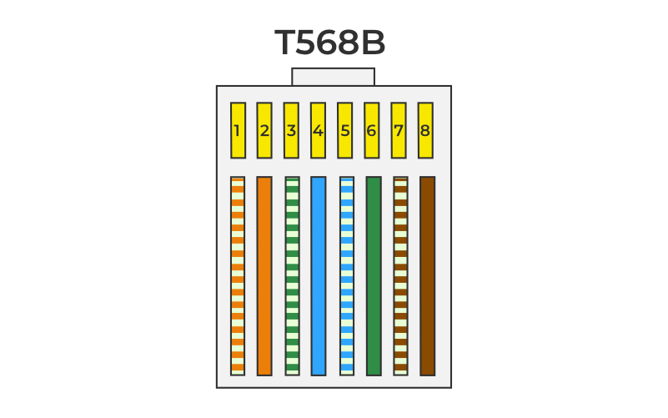
RJ45 CABLE PIN OUT COLOR CODE T568B
Pin | Wire color | Signal | Description
1 | White/Orange | TX1+ | Transmit +
2 | Orange | TX1- | Transmit –
3 | White/Green | RX+ | Receive +
4 | Blue | TX2+ | Bi-Directional Transmit +
5 | White/Blue | TX2- | Bi-Directional Transmit –
6 | Green | RX- | Receive –
7 | White/Brown | TX3+ | Bi-Directional Transmit +
8 | Brown | TX3- | Bi-Directional Transmit –

Slide 14
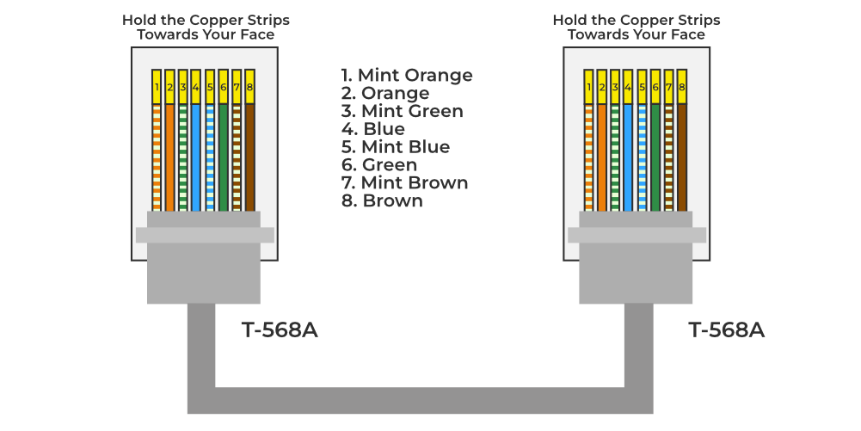

Slide 15
TYPES OF FIBER OPTICS
Single-mode fiber: In single-mode fiber, only one type of ray of light can propagate through the fiber. This type of fiber has a small core diameter (5um) and high cladding diameter (70um) and the difference between the refractive index of core and cladding is very small. There is no dispersion i.e. no degradation of the signal during traveling through the fiber. The light is passed through it through a laser diode.

Slide 16
TYPES OF FIBER OPTICS
Multi-mode fiber: Multimode fiber allows a large number of modes for the light ray traveling through it. The core diameter is generally (40um) and that of cladding is (70um). The relative refractive index difference is also greater than single mode fiber. There is signal degradation due to multimode dispersion. It is not suitable for long-distance communication due to large dispersion and attenuation of the signal. There are two categories on the basis of Multi-mode fiber i.e. Step Index Fiber and Graded Index Fiber. Basically these are categories under the types of optical fiber on the basis of Refractive Index

Slide 17
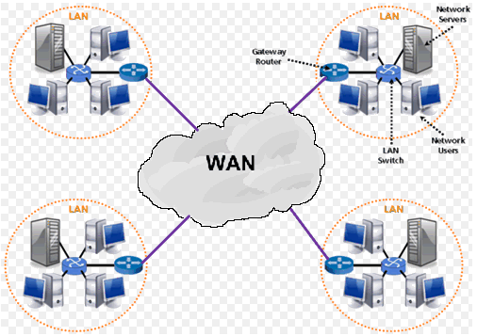
NETWORKING – WAN

Slide 18
WHAT IS A WIDE AREA NETWORK (WAN)?
Wide area networks are a form of telecommunication networks that can connect devices from multiple locations and across the globe. WANs are the largest and most expansive forms of computer networks available to date.
These networks are often established by service providers that then lease their WAN to businesses, schools, governments or the public. These customers can use the network to relay and store data or communicate with other users, no matter their location, as long as they have access to the established WAN. Access can be granted via different links, such as virtual private networks (VPNs) or lines, wireless networks, cellular networks or internet access.

Slide 19
TYPE OF WIDE AREA NETWORK (WAN)
Switched WAN
Point-to-point WAN
Dedicated internet access (DIA) WAN
Broadband internet WAN
Voice over LTE (VoLTE) WAN
MPLS WAN
Software-defined (SD) WAN

Slide 20
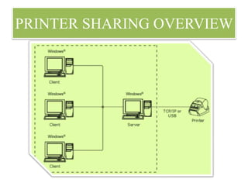
PRINTER SHARING IN NETWORK

Slide 21
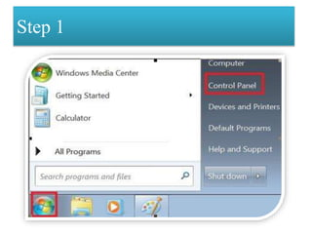
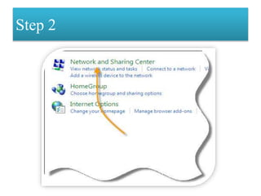
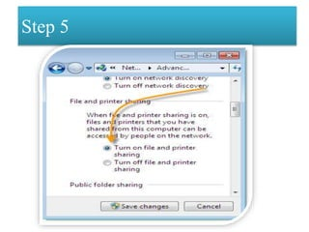
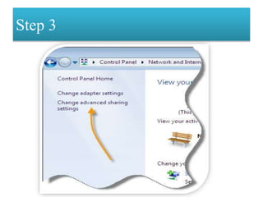
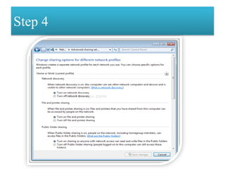
USING CONTROL PANEL

Slide 22
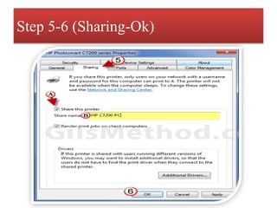
USING DEVICE AND PRINTERS

Slide 23
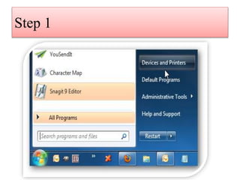
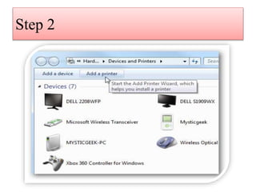
USING ADD PRINTERS Client Computer

Slide 24
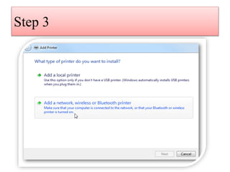
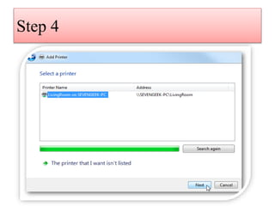
USING ADD PRINTERS Client Computer

Slide 25
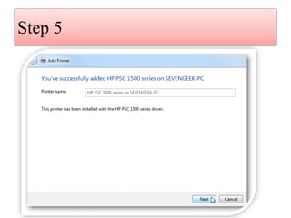
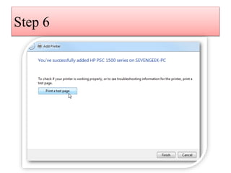
USING ADD PRINTERS Client Computer

Slide 26
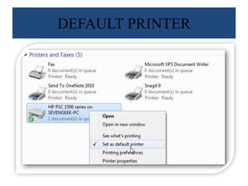
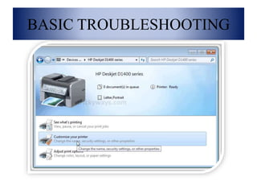
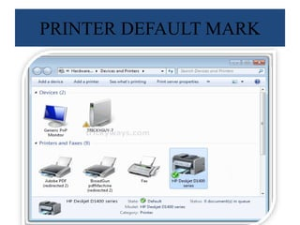
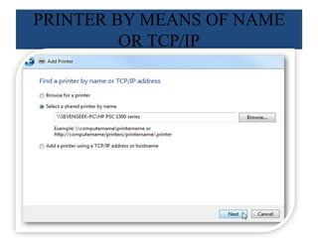
USING ADD PRINTERS Client Computer

Slide 27
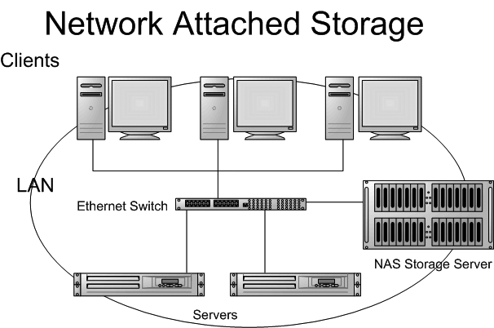
DATA BACKUP
NETWORK ATTACHED STORAGE (NAS)

Slide 28
NETWORK ATTACHED STORAGE (NAS) : Network-attached storage (NAS) is so-called because it connects to and is accessed through a network, not directly from a user’s computer. NAS devices come with a processor and operating system, as well as applications for managing access to files. Devices do not carry a keyboard or display, but are configured and managed through a web-based interface on a connected machine.
NAS devices can be connected to a local business or home network using an ethernet cable or a Wi-Fi-enabled network to allow authorized users to connect remotely.
EXTERNAL HARD DRIVE : External hard drives are a popular choice for data backup due to their convenience and ease of use. These devices connect to your computer via USB or other connection types and offer a large amount of storage space for your data. External hard drives are portable, allowing you to easily move and store your data off-site for added security. They also provide a relatively fast backup process compared to other methods, such as removable media.
CLOUD STORAGE : In this fast-moving world it become necessary to store data on the cloud storage. The biggest advantage of cloud storage is that we can store any type of data in digital form on the cloud. Another advantage of cloud storage is that we can access data from anywhere, anytime on any device. There are many cloud storage providers such as, Google Drive, Dropbox, OneDrive, iCloud, etc. They provide free service for limited storage but if you want to store beyond the limit, you have to pay. In this section, we will discuss what is cloud storage, uses of cloud storage, and its architecture in detail.

Slide 29
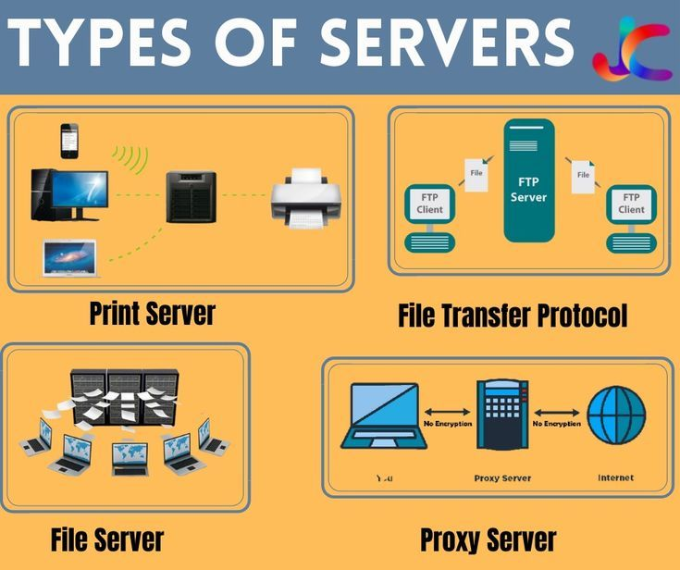
SERVERS

Slide 30
WHAT IS SERVER
A server is a specialized computer or software system designed to provide services, data, or resources to other computers, known as clients, over a network. These services can range from delivering web pages and email to storing and managing files or running applications. These machines run on a client-server model, where clients request specific services or resources, and the server fulfills these requests.
WHAT DOES A SERVER DO ?
Servers are the digital workhorses that power much of our modern world. To understand their significance, it’s essential to grasp the wide array of tasks they can perform. Here, we explore the multifaceted role of servers and the core functions they execute

Slide 31
TYPES OF SERVERS
WEB SERVER
FILE SERVER
DATABASE SERVER
EMAIL SERVER
APPLICATION SERVER
PROXY SERVER
PRINT SERVER
DNS SERVER
GAME SERVER
FTP SERVER
MEDIA SERVER
EMAIL SERVER
AUTHENTICATION SERVER
TOWER SERVER
RACK SERVER
BLADE SERVER

Slide 32
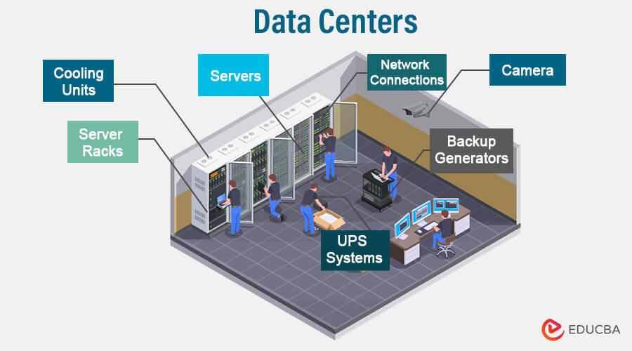
DATA CENTERS

Slide 33
WHAT IS A DATA CENTER ?
A data center is a physical location that stores computing machines and their related hardware equipment. It contains the computing infrastructure that IT systems require, such as servers, data storage drives, and network equipment. It is the physical facility that stores any company’s digital data.
WHAT IS INSIDE A DATA CENTER ?
Most enterprise data center infrastructure falls into three broad categories:
Compute
Storage
Network
Also, data center equipment includes support infrastructure like power systems, which help the main equipment function effectively.

Slide 34
TROUBLESHOOTING PROBLEMS OF LAPTOPS
YOUR COMPUTER DOES NOT TURN ON
You press the power button, and nothing happens. One common laptop problem is a complete failure for the device to turn on, and it can leave you without access to your important files and programs. If the laptop seems like it is dead and does not make any sounds or light up, there are a few possible causes and solutions.
First, make sure your computer is charged. If you believe it has been charged, your AC adapter might have failed. You can test the AC adapter with a voltmeter or test a new adapter. If your AC adapter isn’t to blame, the DC jack may have failed, keeping power from your computer, or the issue is with your motherboard.

Slide 35
THE SCREEN IS BLANK
If your laptop shows signs that it is on, such as lights or sounds, but the screen remains blank, you are left unable to use your computer. This issue can be particularly frustrating because your machine appears to be functional except for the screen. First, try to unplug your laptop from its power source and remove the battery. Press and hold the power button for about a minute before plugging it back in and restarting your computer. Finally, replace the battery and restart the laptop again.
If that process does not work, you may be experiencing a memory failure. Check that the memory modules are making contact with the slot. It may be necessary to replace the memory modules altogether.
You can also try removing components like your hard drive, modem, or keyboard to determine what is causing the issue. If your screen is still blank after these tests, the motherboard or processer is likely to blame

Slide 36
LAPTOP TURNS ON & OFF REPEATEDLY
You may power on your laptop only for it to turn off and on again on its own. The laptop may shut down completely, or you could be left with a flickering display that makes it impossible to see the screen. Start by checking your memory modules or replacing them. If that does not resolve the issue, your motherboard may be to blame.
THE LAPTOP MAKES WEIRED NOISE WHILE RUNNING.
Most laptops make some noise when they are on, typically the whirl of the device’s fan. However, you may notice your laptop making more unpleasant sounds while it is running. If you notice a grinding noise or a rattling sound, you need to check the cooling fan.
If your laptop is still making noises even if the fan is not spinning, the sound is likely coming from your hard drive; You can back up your important files and data before replacing the hard drive.

Slide 37
LAPTOP SHUTS DOWN OR FREEZES
You get on your computer and start working, only for it to freeze a few minutes later or shut down on its own. This frustrating occurrence can lead to lost data and unsaved files, but it will also cause you to worry about the state of your laptop. If your laptop shuts down or freezes, test the bottom. If it is hot or you notice the fan working harder than usual, the issue is likely related to heat. Clean out your fan and heat sink to prevent dust from clogging up and blocking the processor from cooling.
THE BATTERY DOES NOT CHARGES PROPERLY
If your laptop does not charge properly or at all, there is a possible easy fix. Adjust your AC adapter plug by moving the cord slightly to alter the position in the power connector. Your laptop may indicate that it is charging again, or you may notice that your adaptor cord is frayed or otherwise damaged. When your battery fails, you will need to replace it.

Slide 38
SCREEN LIGHT FAILS
Dim screens or failing screen lights can cause you to strain your eyes as you attempt to view your laptop screen. If everything else works on your laptop, you may be experiencing a screen inverter or backlight lamp failure. Try replacing these components to repair your screen light failure.
THE STRANGE OR GARBLED IMAGE ON THE SCREEN
You may notice that the image on your screen is distorted or odd in some way. Whether the image appears warped or the colors are off; it can be difficult to accomplish tasks on your laptop. Try using your laptop with an external monitor. If the image appears strange on the screen, your graphics card is to blame. If the problem is limited to your laptop screen, you can have an issue with your motherboard, video cable, or display.
.

Slide 39
KEYBOARD KEYS STOPPED WORKING
Have you ever been typing only to realize that several letters are missing or keyboard keys bring up the wrong characters? Sticking keys could be the problem, so you should try removing the keycaps and carefully cleaning beneath them. If this does not resolve the issue, your keyboard may need to be replaced.
REPETITIVE BEEP SOUND ON STARTING
When you power on your laptop, you expect the typical startup noises. If you are met with repetitive beeping sounds and a blank screen, try pressing your keyboard. Sometimes a stuck key can cause issues on startup, but it is usually an easy fix.
.

Slide 40
SLOW PERFORMANCE
Laptops tend to slow down over time due to various factors. Accumulated junk files, outdated software, and insufficient memory can all contribute to this problem. To boost your laptop’s speed:
Delete Unnecessary Files: Remove unused programs and files to free up storage space.
Upgrade RAM: Adding more RAM can significantly improve performance.
Software Updates: Ensure your operating system and software are up to date.
Disk Cleanup: Use built-in tools like Windows Disk Cleanup to remove temporary files.
WI-FI CONNECTIVITY PROBLEM
Restart Your Router: Rebooting your router can resolve temporary connectivity problems.
Check Network Settings: Ensure you’re connected to the correct network and that airplane mode is off.
Update Network Drivers: Outdated drivers can cause connectivity issues.

Slide 41
HARDWARE FAILURES
Check Connections: Ensure all external devices are properly connected.
Run Diagnostic Tests: Many laptops have built-in diagnostics for hardware troubleshooting.
SOFTWARE CRASHES
Update Software: Ensure all software is up to date, including drivers.
Check for Conflicts: Identify conflicting software that may be causing crashes.
Reinstall Problematic Software: If all else fails, reinstall the problematic software.
DATA LOSS
Regular Backups: Schedule automatic backups of your important files.
Cloud Storage: Use cloud services for additional data redundancy.
Data Recovery Tools: In case of data loss, consider using data recovery software.

Slide 42
WAYS TO FIX A LAPTOP THAT WON’T CONNECT TO WI-FI
Wi-Fi Button Taskbar
Turn Off Airplane Mode
Restart Windows Explorer
Forgot Saved Wireless Network
Restart Your Router
Reduce Wireless Signal Interference
Windows Services - Renew Your IP Address

Slide 43
THANK YOU
By :-
Naveen Mittal
9837232876
naveen@hawktek.co.in

